Slide 1

Technical Hub | Project Report | 6 April 2023 | Page 1-8
Container Orchestration System Utilizing Kubernetes
Project Presentation
K8s Wizards
-Siva Ganesh
-Ravindra Reddy
-Shiva
-Manoj

Slide 2
Technical Hub | Project Report | 6 April 2023 | Page 2-8
Requirements
01.
02.
03.
Purpose of Project
Technologies Used
Tools Used
The purpose of container orchestration using Kubernetes is to automate the deployment, scaling, and management of containerized applications.
Kubernetes
Docker
Docker Desktop
Minikube
kubectl
Helm
Prometheus
Grafana
Git Bash
Chocolatey

Slide 3
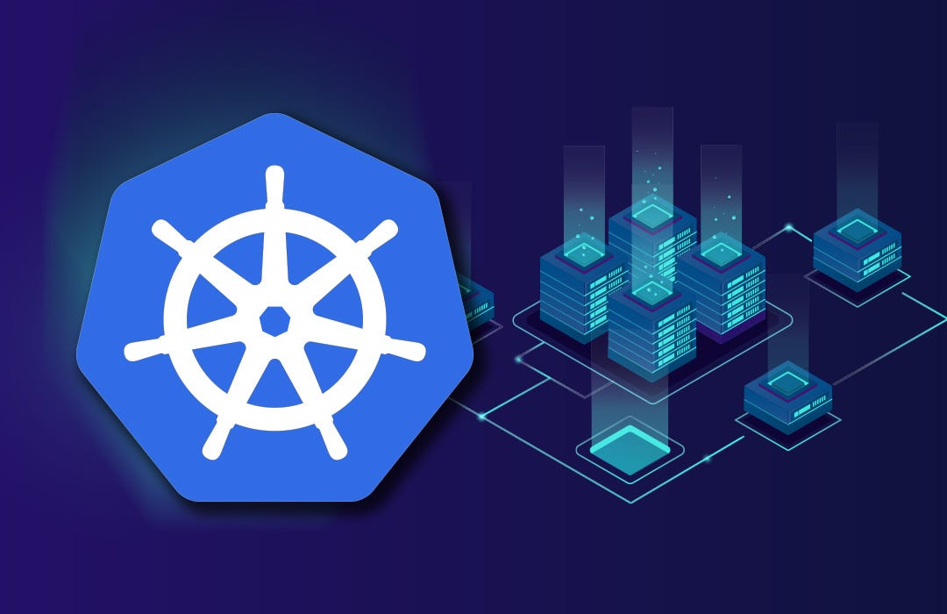
Technical Hub | Project Report | 6 April 2023 | Page 3-8
Introduction
Kubernetes (also known as k8s or “kube”) is an open-source container orchestration platform that automates many of the manual processes involved in deploying, managing, and scaling containerized applications.
Why use Kubernetes for orchestration?
•Automatic Bin packing.
•Service Discovery & Load balancing.
•Storage Orchestration.
•Self-Healing.
•Secret & Configuration Management.
•Batch Execution.
•Horizontal Scaling.
•Automatic Rollbacks & Rollouts.

Slide 4
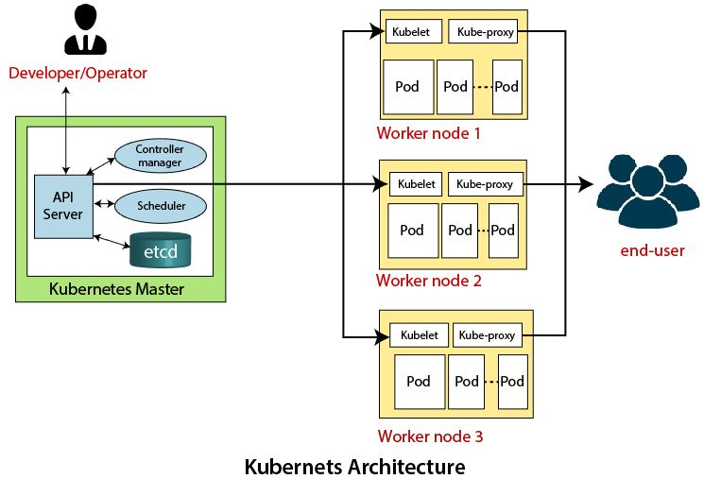
Technical Hub | Project Report | 6 April 2023 | Page 4-8
Architecture of Kubernetes
The architecture of Kubernetes follows the client-server architecture. It consists of the following two main components
Master Node: The master node in a Kubernetes architecture is used to manage the states of a cluster. It is an entry point for all types of administrative tasks.
Slave/worker node: The Worker node in Kubernetes is also known as minions. A worker node is a physical machine that executes the applications using pods. It contains all the essential services which allow a user to assign resources to the scheduled containers

Slide 5
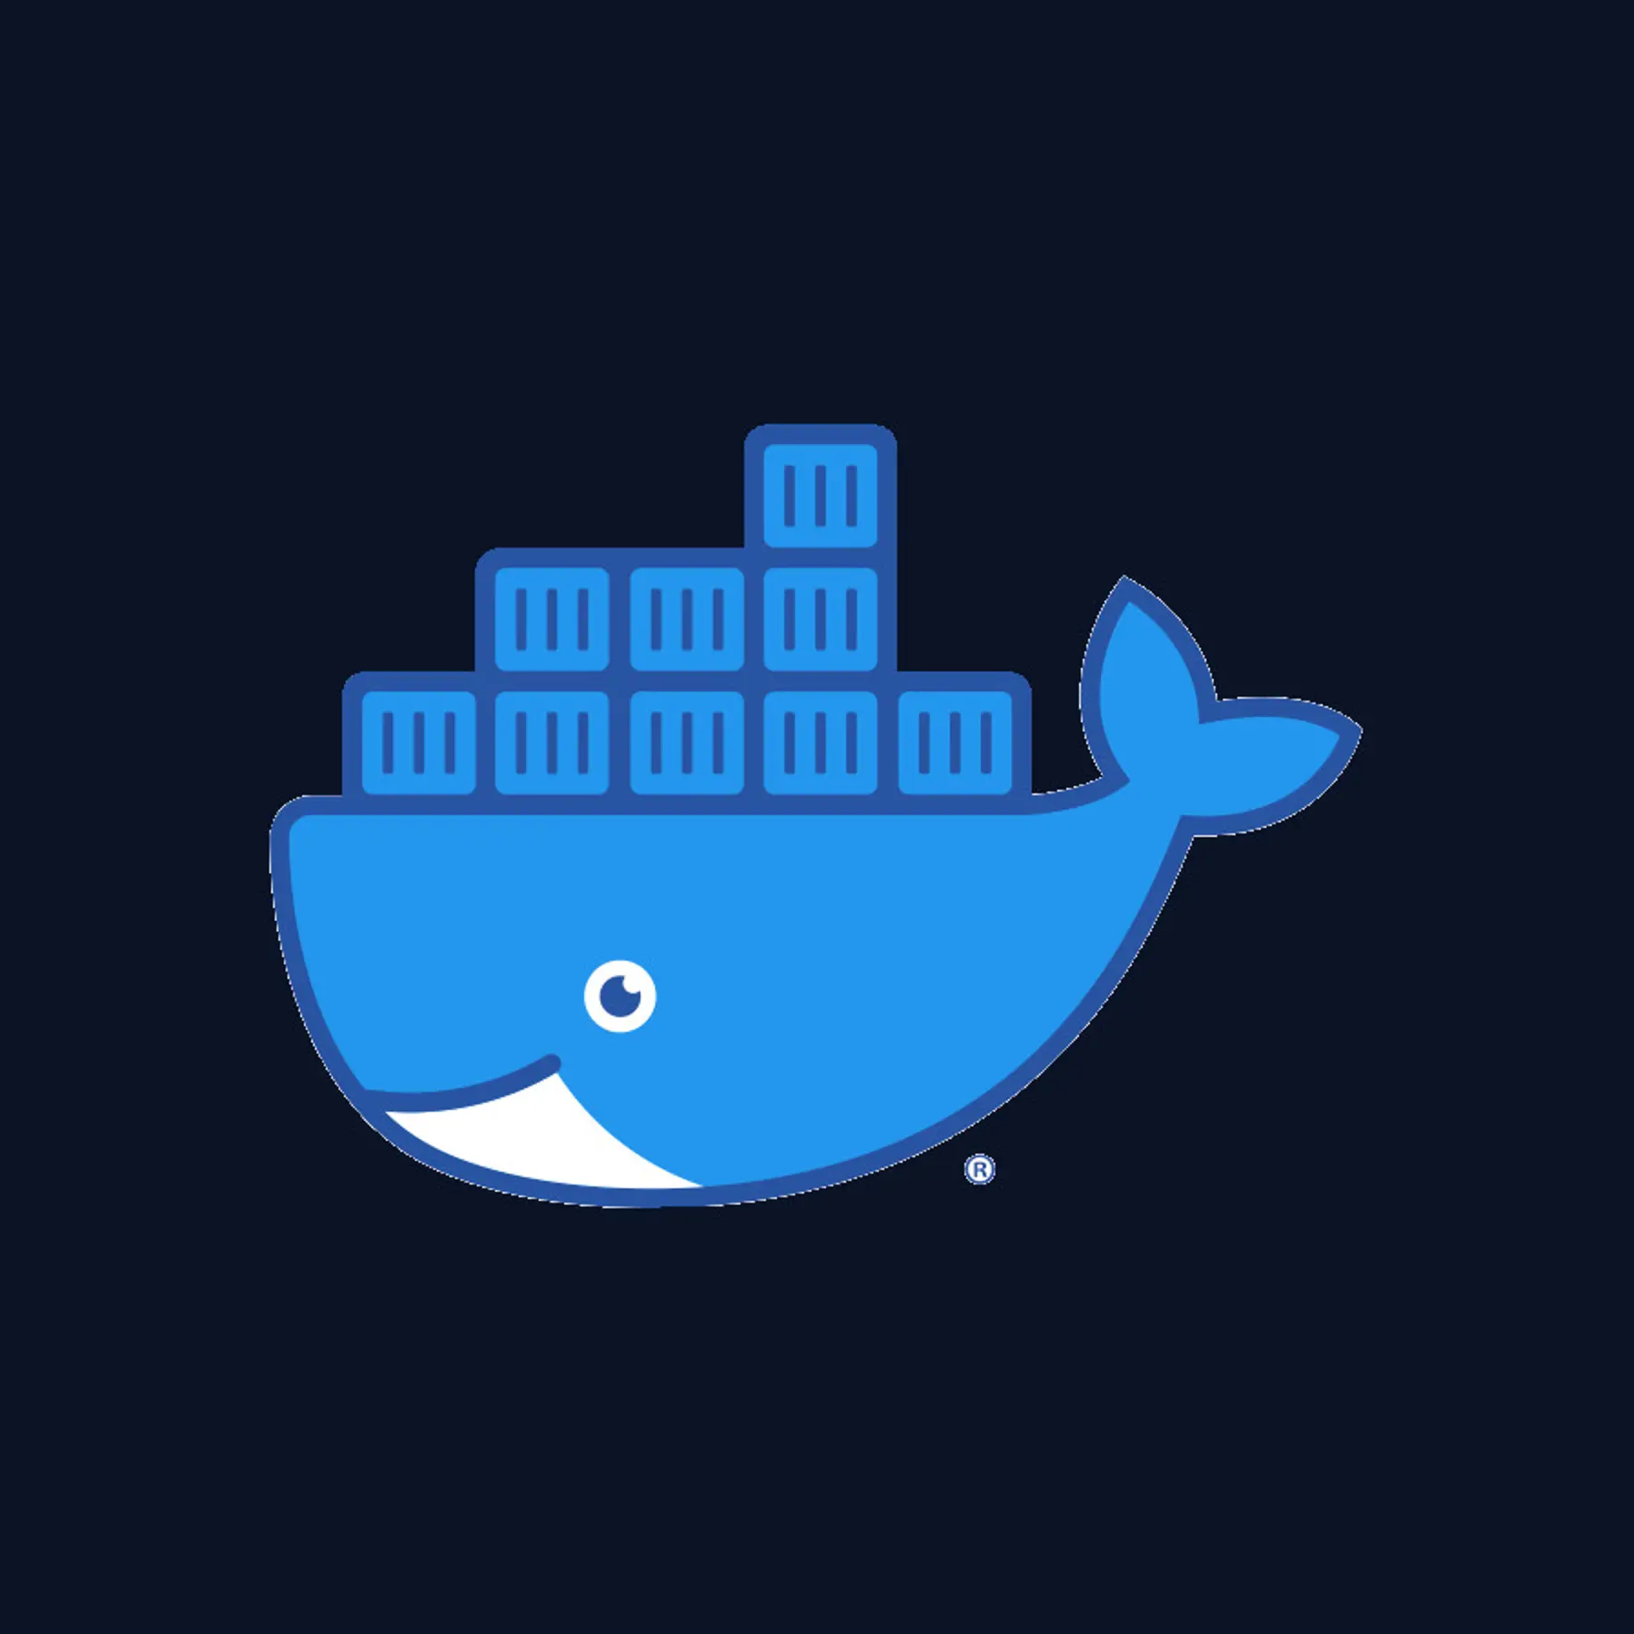

Technical Hub | Project Report | 6 April 2023 | Page 5-8
Key Tools for the Project
DOCKER DESKTOP
Docker is an open-source containerized platform that Is used for developing, deploying, and managing applications in lightweight virtualized environments called containers.
Docker creates the containers that Kubernetes orchestrates. Docker allows developers to package and ship their applications as containers, and Kubernetes provides a way to manage and scale those containers across a cluster of nodes, providing a highly-available and resilient environment for running modern applications.
MINIKUBE
Minikube is a lightweight Kubernetes implementation that creates a VM on your local machine and deploys a simple cluster containing only one node.

Slide 6

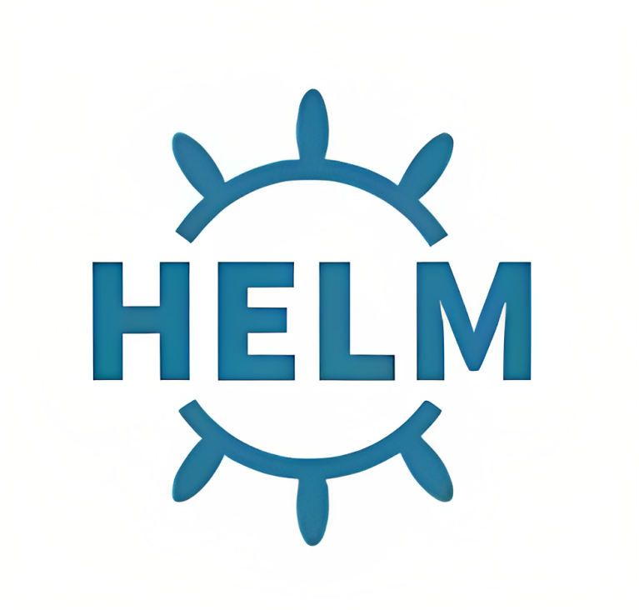

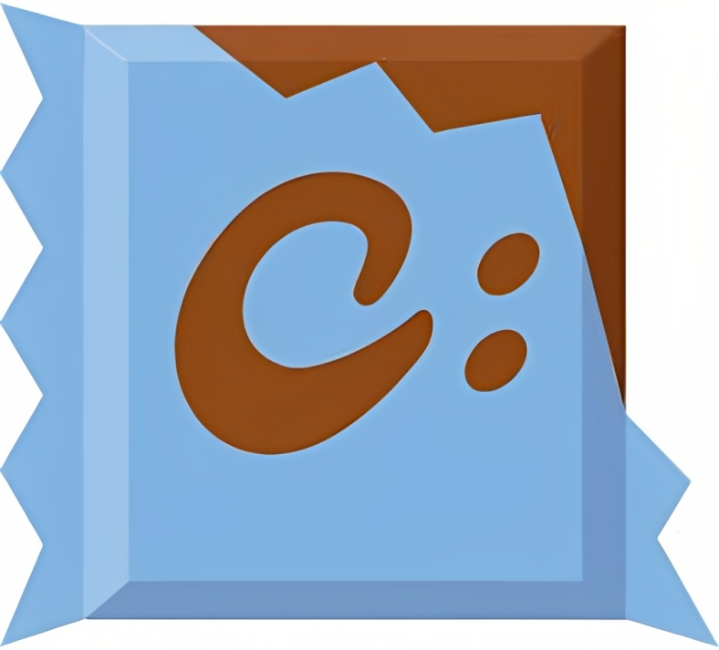
Technical Hub | Project Report | 6 April 2023 | Page 6-8
Key Tools for the Project
CHOCOLATEY
HELM
Prometheus
GRAFANA
Chocolatey is most commonly used to get software and software updates installed on many machines at once. Like many DevOps tools, Chocolatey is used to automate repetitive tasks.
Helm is a tool that automates the creation, packaging, configuration, and deployment of Kubernetes applications by combining your configuration files into a single reusable package
Prometheus collects rich metrics and provides a powerful querying language; Grafana transforms metrics into meaningful visualizations
Grafana is an open-source data visualization and monitoring platform that allows users to query, visualize, and alert on metrics and logs from a variety of data sources.

Slide 7
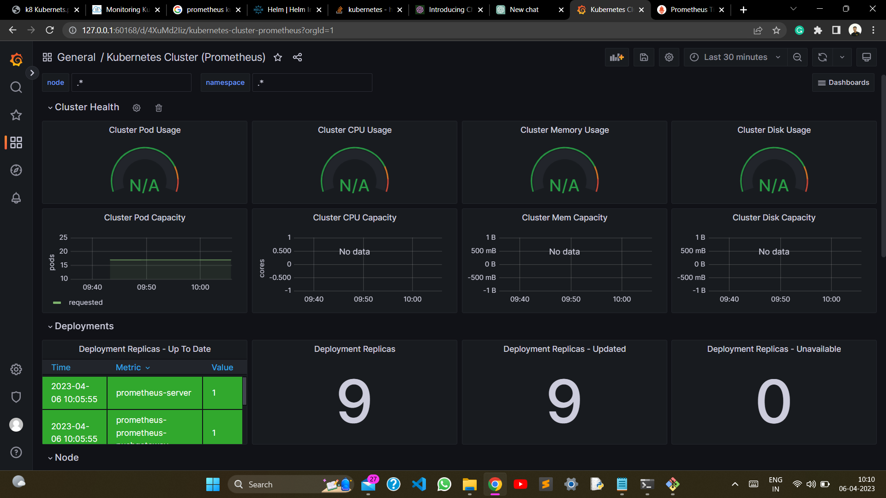
Technical Hub | Project Report | 6 April 2023 | Page 7-8
Outcomes
Successfully created a node in Minikube, which allows for local development and testing of Kubernetes environments.
Deployed four pods, each containing a web application container, which enables scaling and load balancing of the web application.
Deployed Prometheus and Grafana, which provide monitoring and visualization of metrics for the web application containers.
Observed metrics and graphs in Grafana, which helps to identify issues and optimize the performance of the web application.
Conclusion
Overall, the successful completion of this project demonstrates a solid understanding of Kubernetes, containerization, monitoring, and visualization. The use of Minikube allowed for the creation of a local environment, which is useful for testing and development purposes. The deployment of multiple pods with a web application container in each pod allowed for scalability and redundancy. The deployment of Prometheus and Grafana helped to monitor the web application containers and provided a visualization of metrics to help identify any issues. By observing metrics and graphs in Grafana, it is possible to optimize the performance of the web application containers and ensure they are running efficiently. Overall, this project highlights the importance of monitoring and visualization in ensuring the reliability and scalability of Kubernetes environments.

Slide 8

Technical Hub | Project Report | 6 April 2023 | Page 8-8

